Slide 1
Diffusion models for generating background events: first results
Korl Železnikar,
December 2025

Slide 2
Introduction
Promising frameworks: standard stohastic DDPM, EDM framework?
Data is transformed using a rank transform, with an inv. Erf(x) transfromation to a normal distribution – the models learn the deviations, preconditioning can help helps
Score networks: ODE sampling = less steps, faster but lowers samples‘ variance – not good for sampling

Slide 3
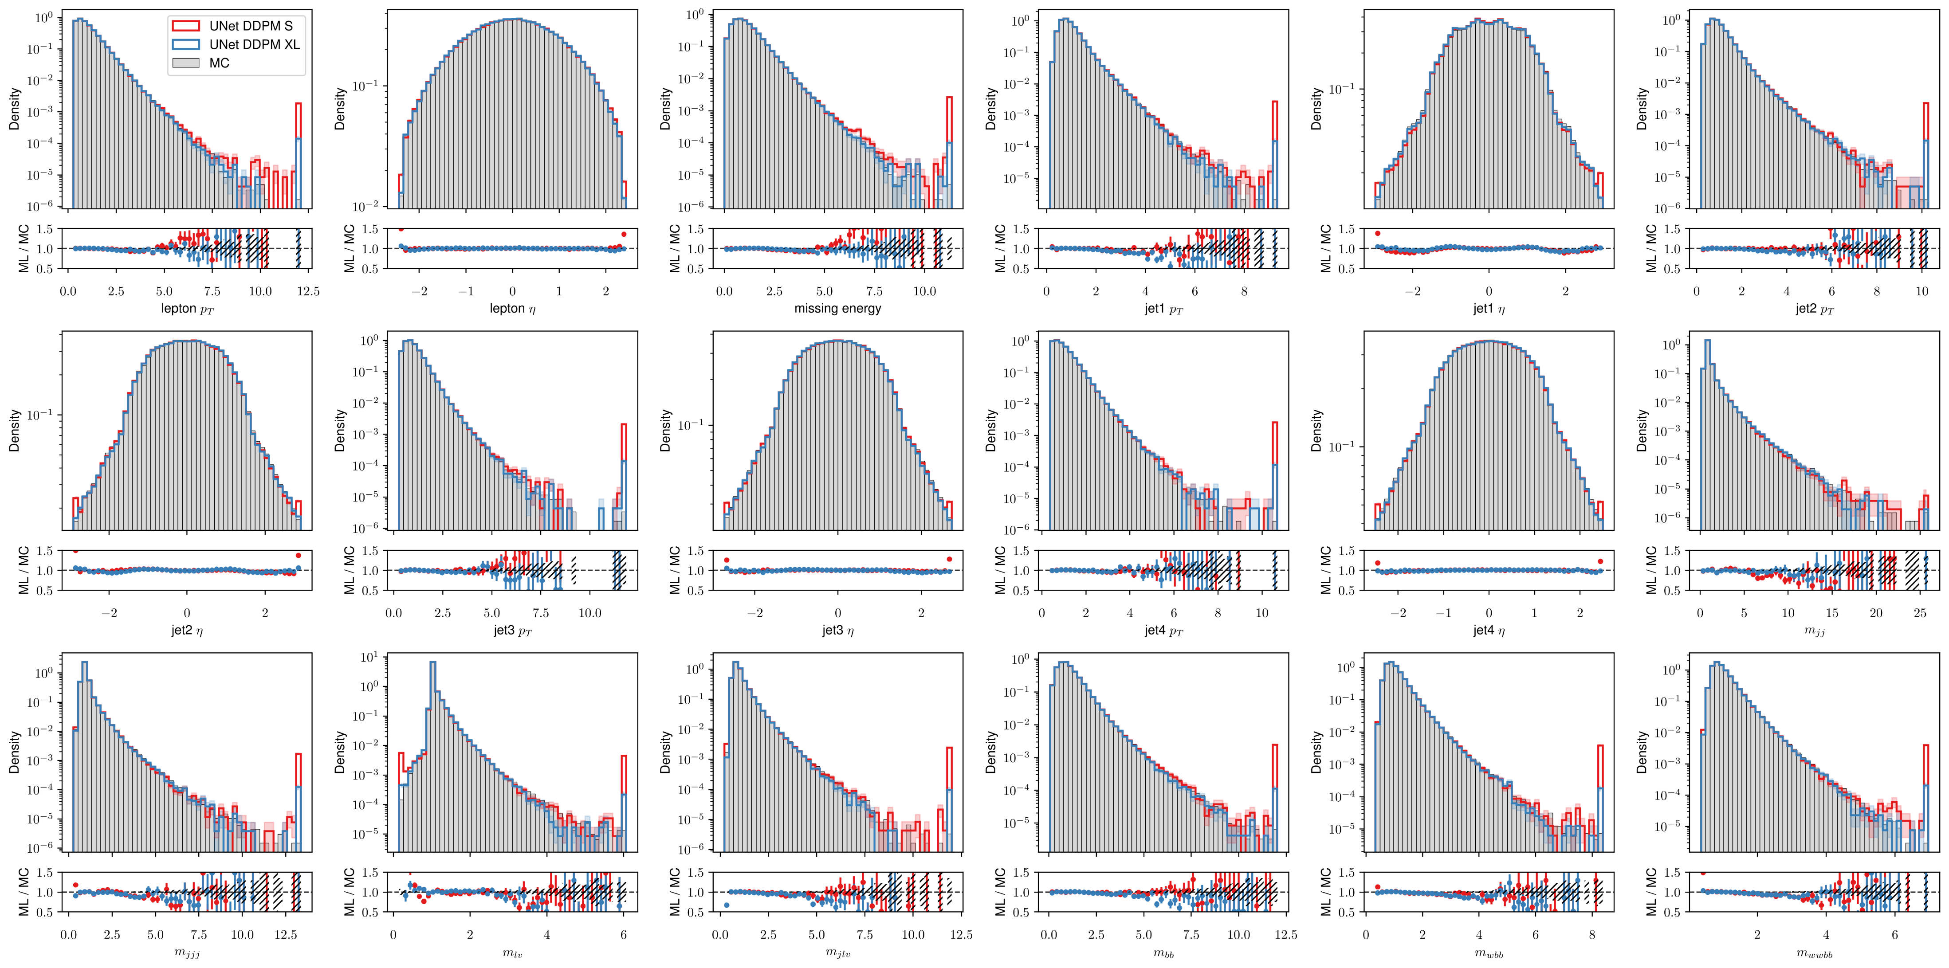
DDPM sampling
After sampling the transformed data, all the outliers are mapped to tails

Slide 4
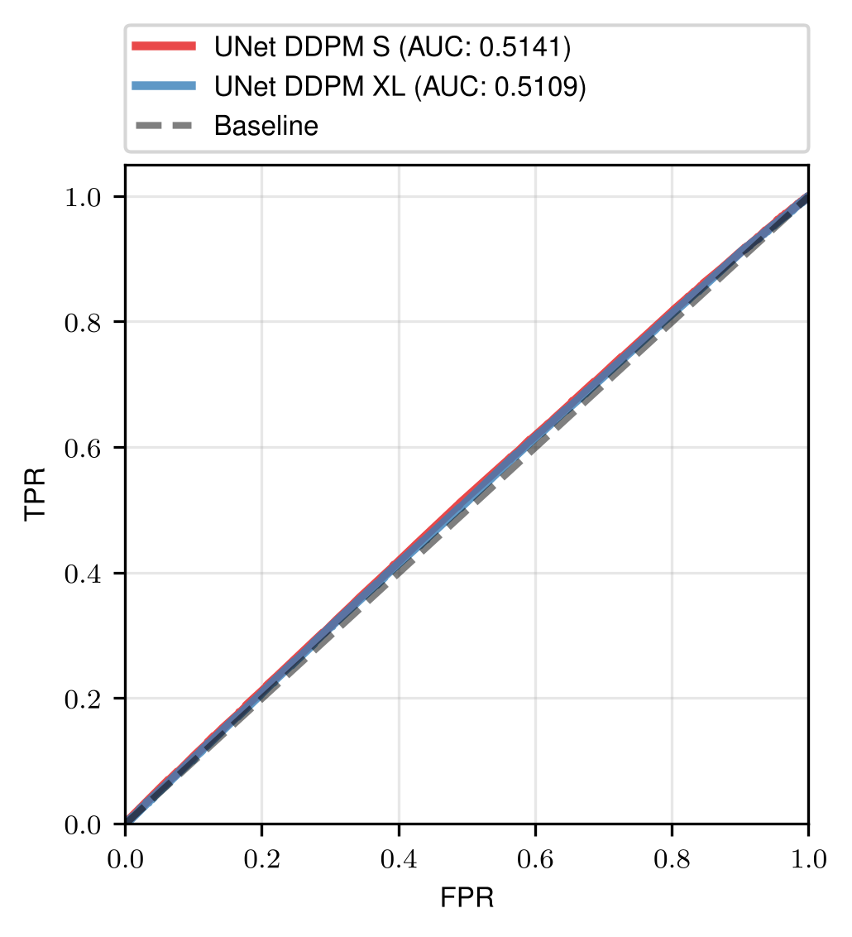
C2ST tests
Tested for 10⁶ generated samples

Slide 5
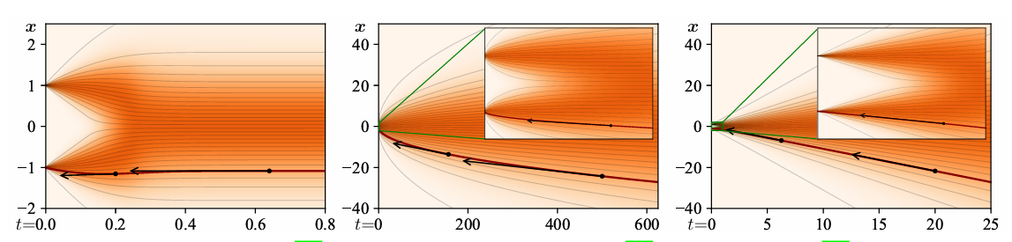
Score based frameworks
Variance preserving – continuous version of DDPM, stable
Variance exploding – nonlinear at the end steps
EDM – straightest trajectories = better sampling? (in theory)
VP
VE
DDIM/EDM

Slide 6
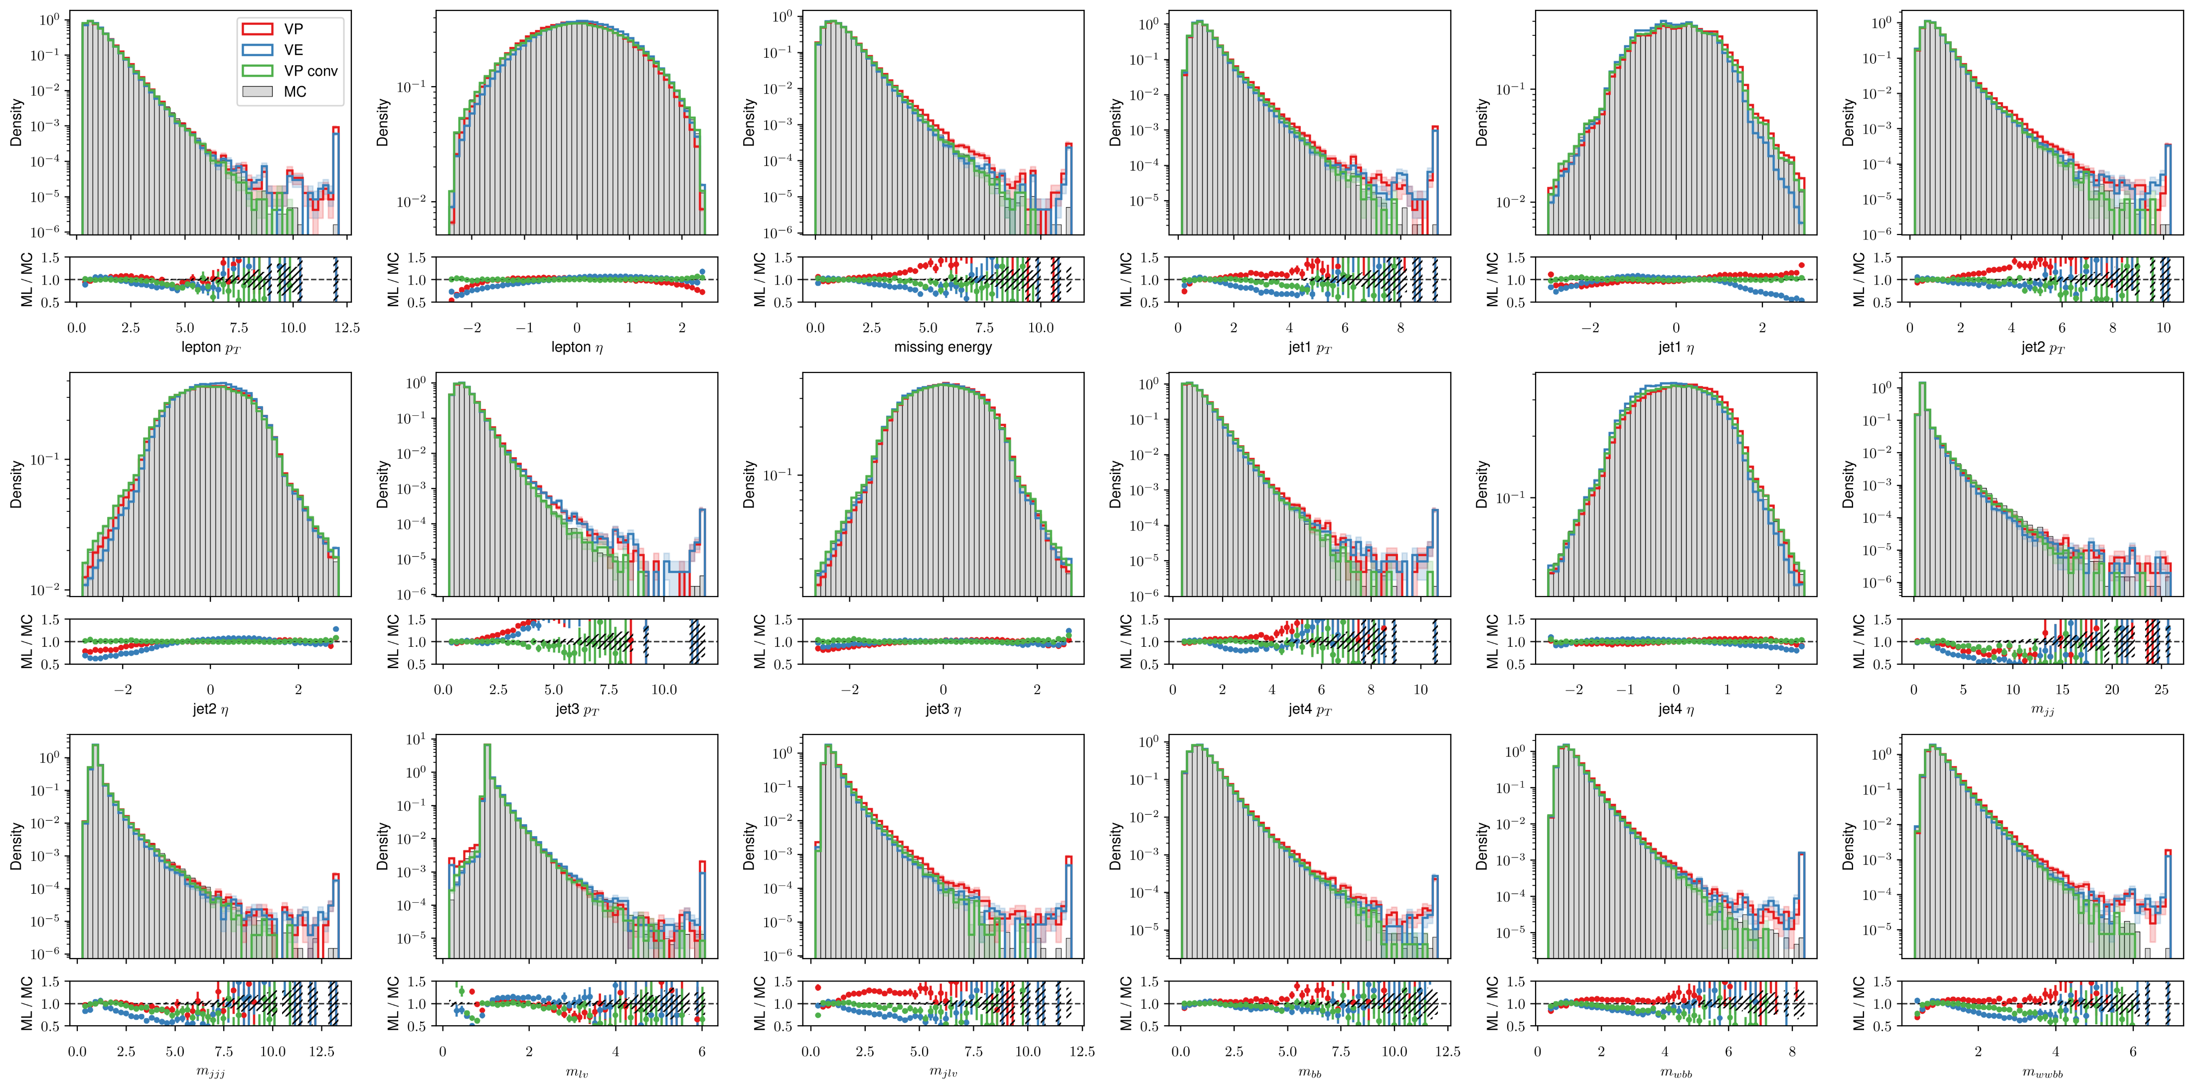
VP, VE, VP (conv. net) samples

Slide 7
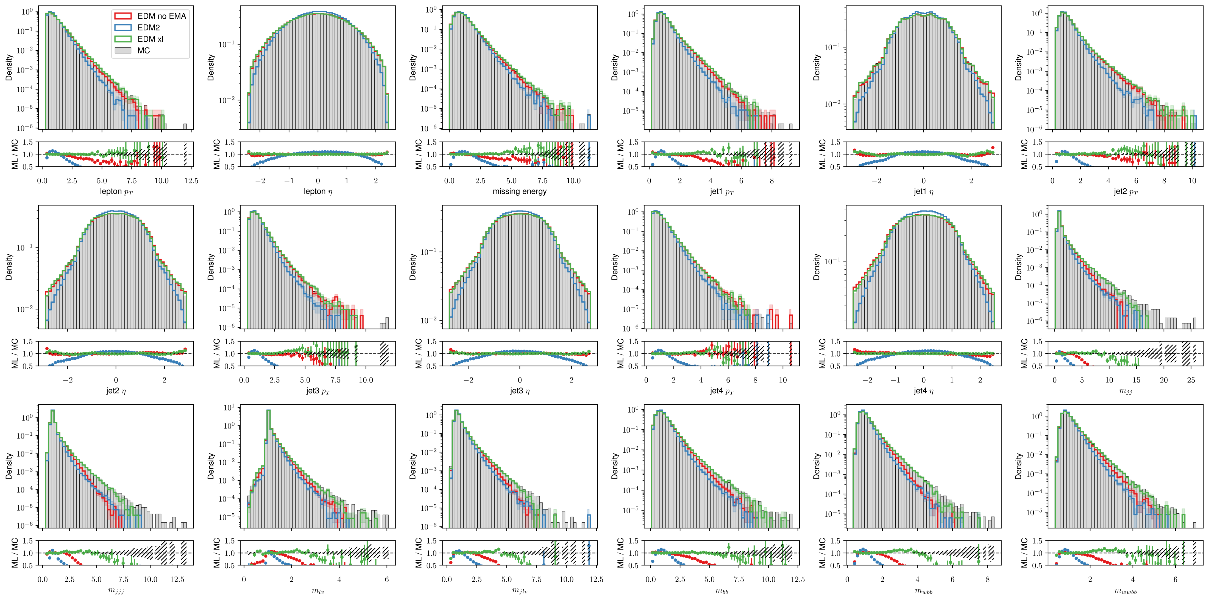
EDM, EDM2 samples
Variance undershooting problems/samples converge to the middle in high level features

Slide 8
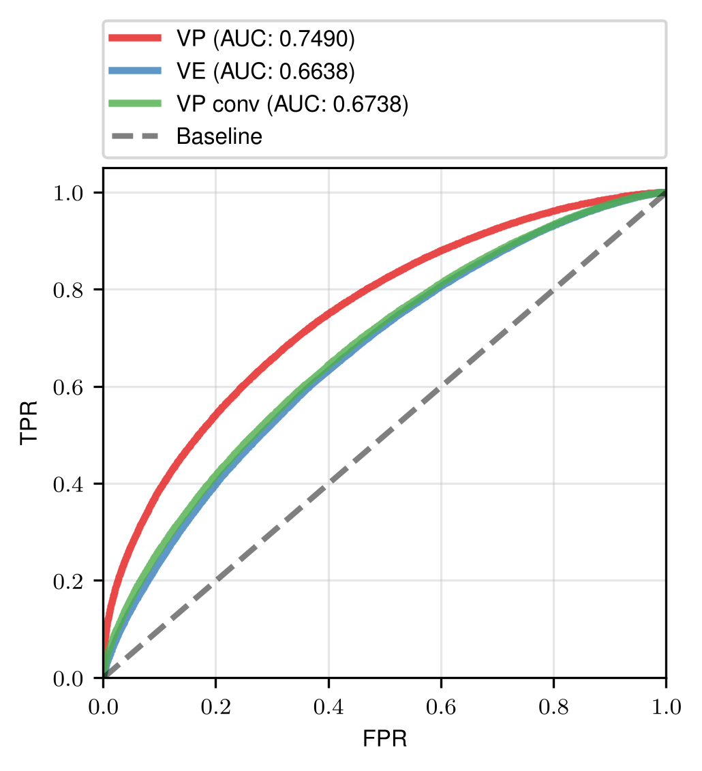
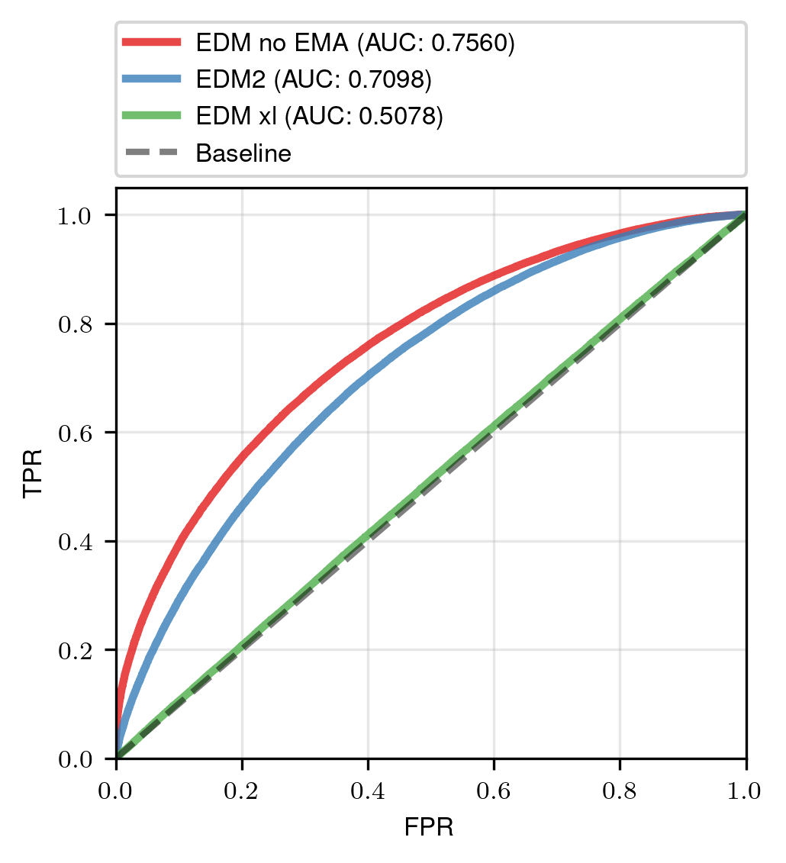

Slide 9
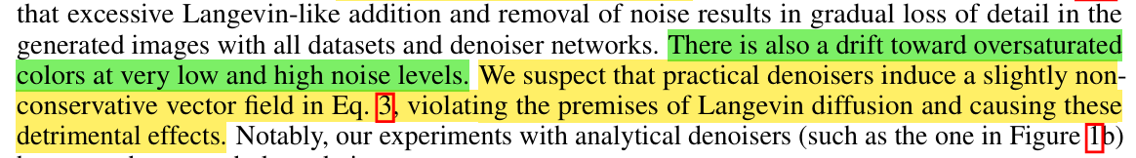
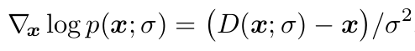


Problems with training
These have been „optimized“, but variance still remains too low after training.

Slide 10
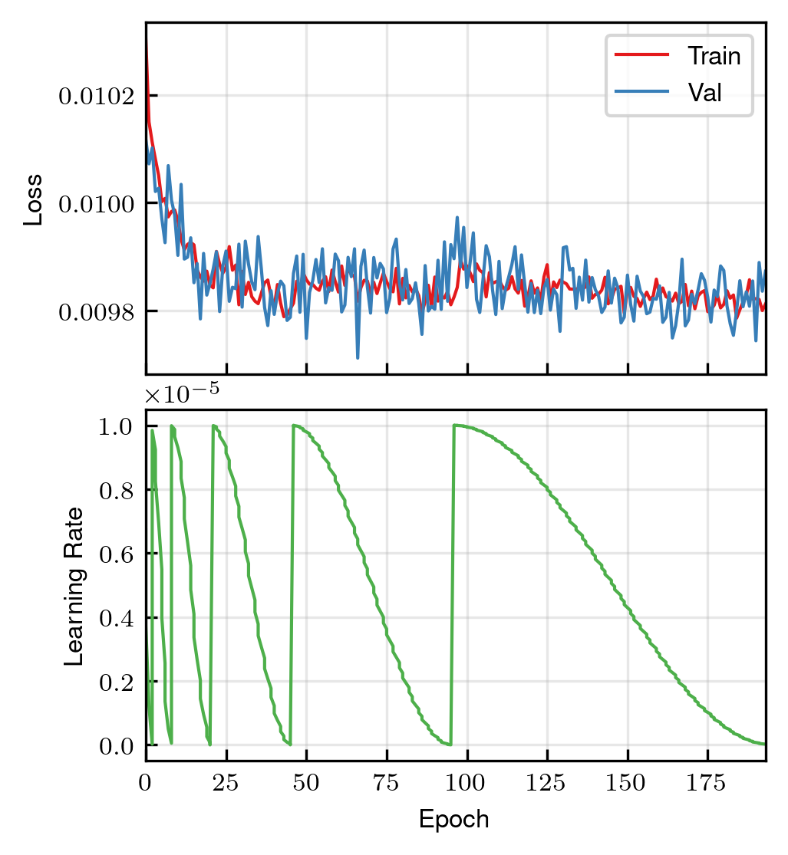
EDM training
Starting loss already small, then it barely improves
Noisy even at low learning rates (1E-5)

Slide 11
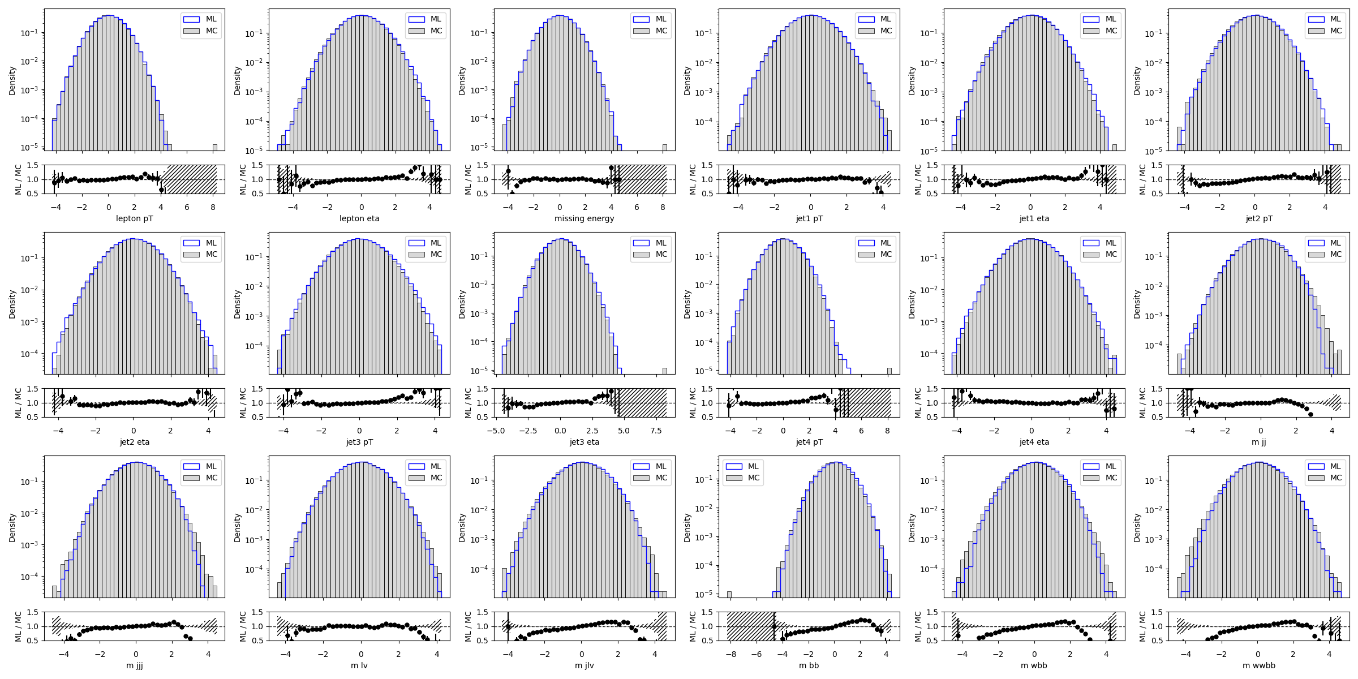
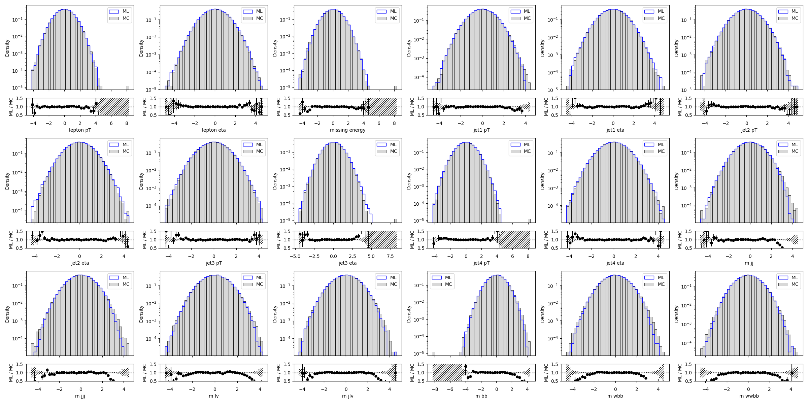
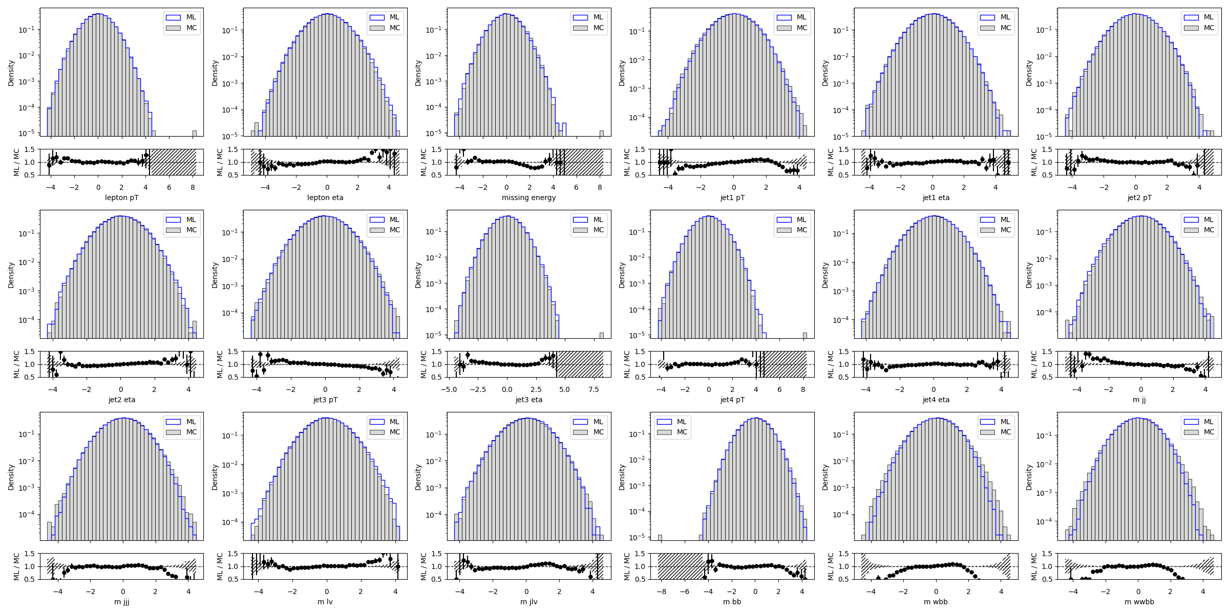
Training sampled snapshots for EDM
Epoch 192/196
Epoch 93/196
Epoch 0/196

Slide 12
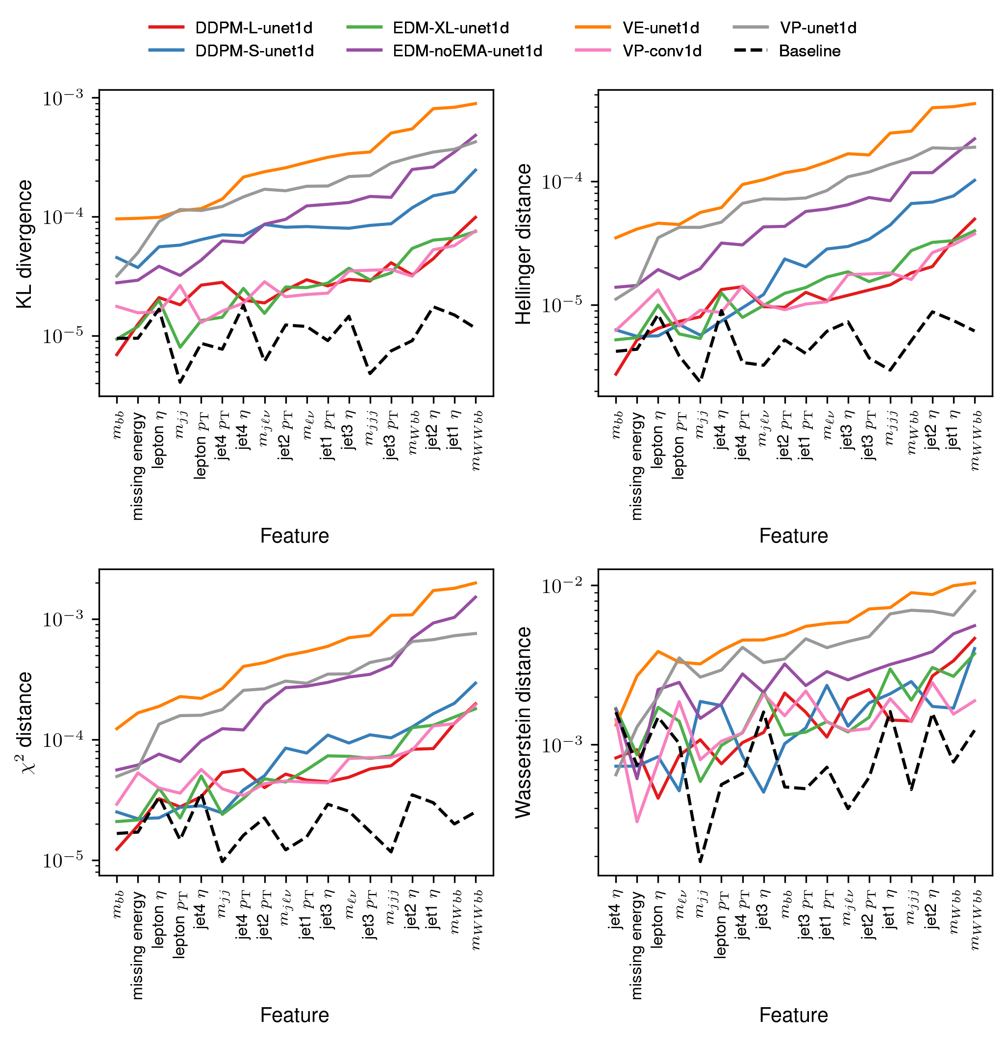
Model distances
Best performers: EDM xl, VP conv. and DDPM
VP conv. C2ST test still underperforms
Invariant masses hardest to predict

Slide 13
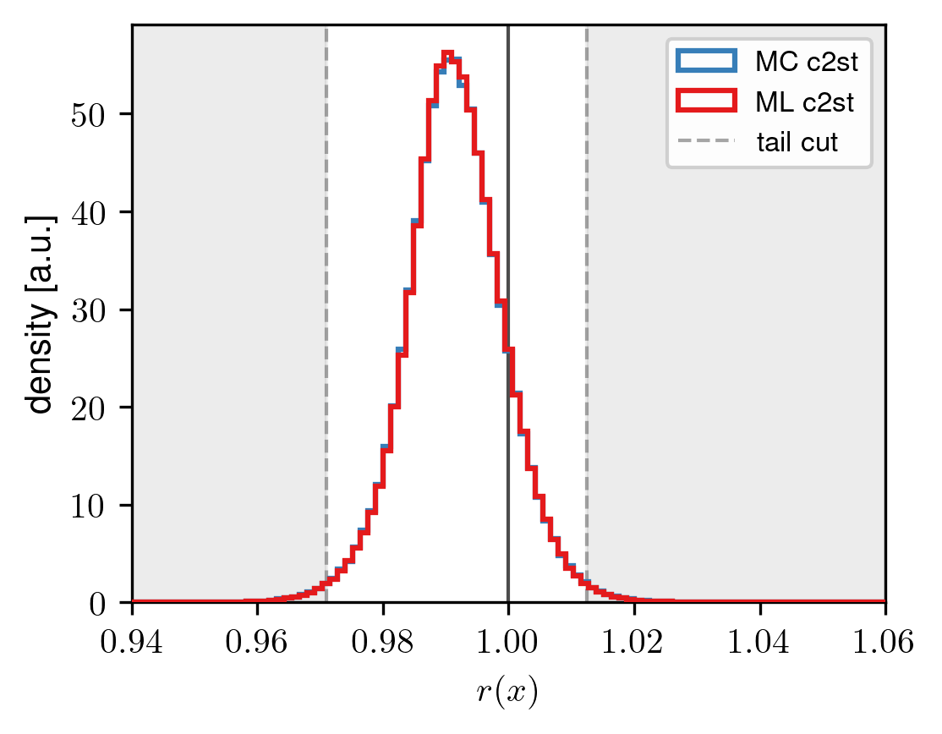
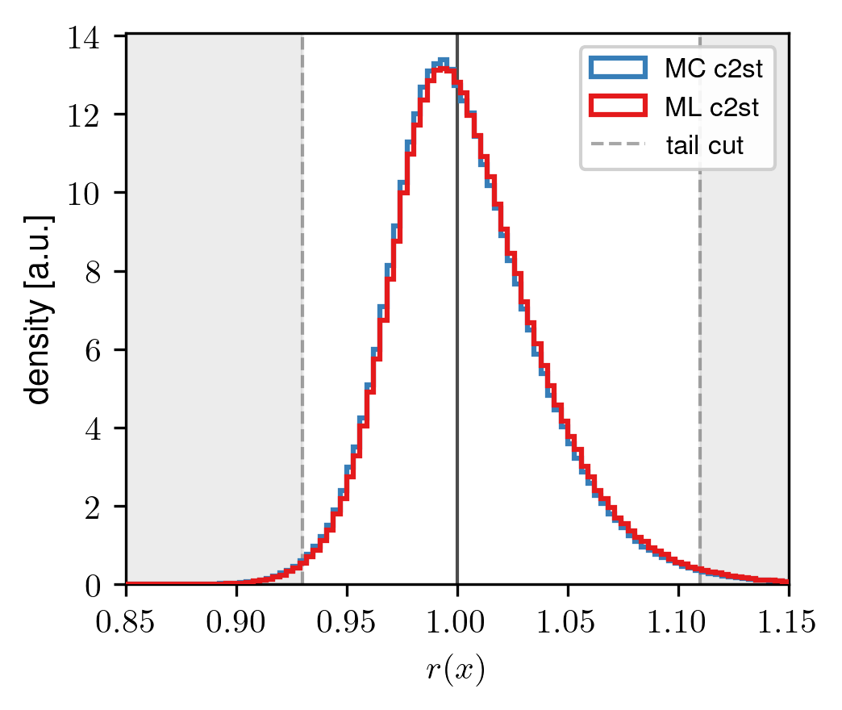

Ratio tests
Classifier output
~1.5 % of data in the cuts, r(x) estimated as r(x)≈exp($σ^{−1}$[f(x; $θ$)])
DDPM
EDM (xl model)

Slide 14
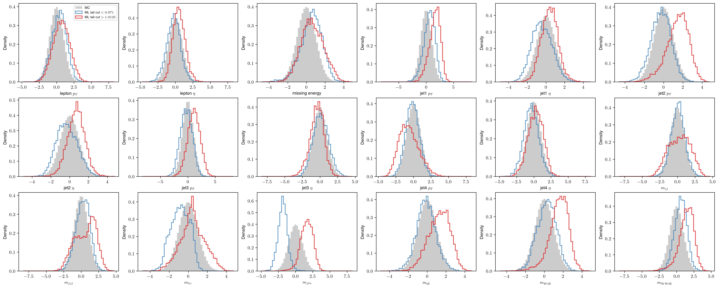
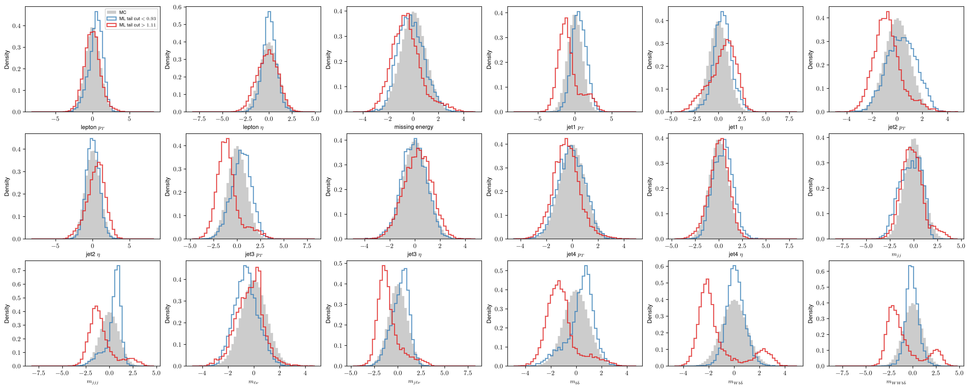
Distributions after the cut
EDM struggles with high level features, low varince problem
EDM
DDPM

Slide 15
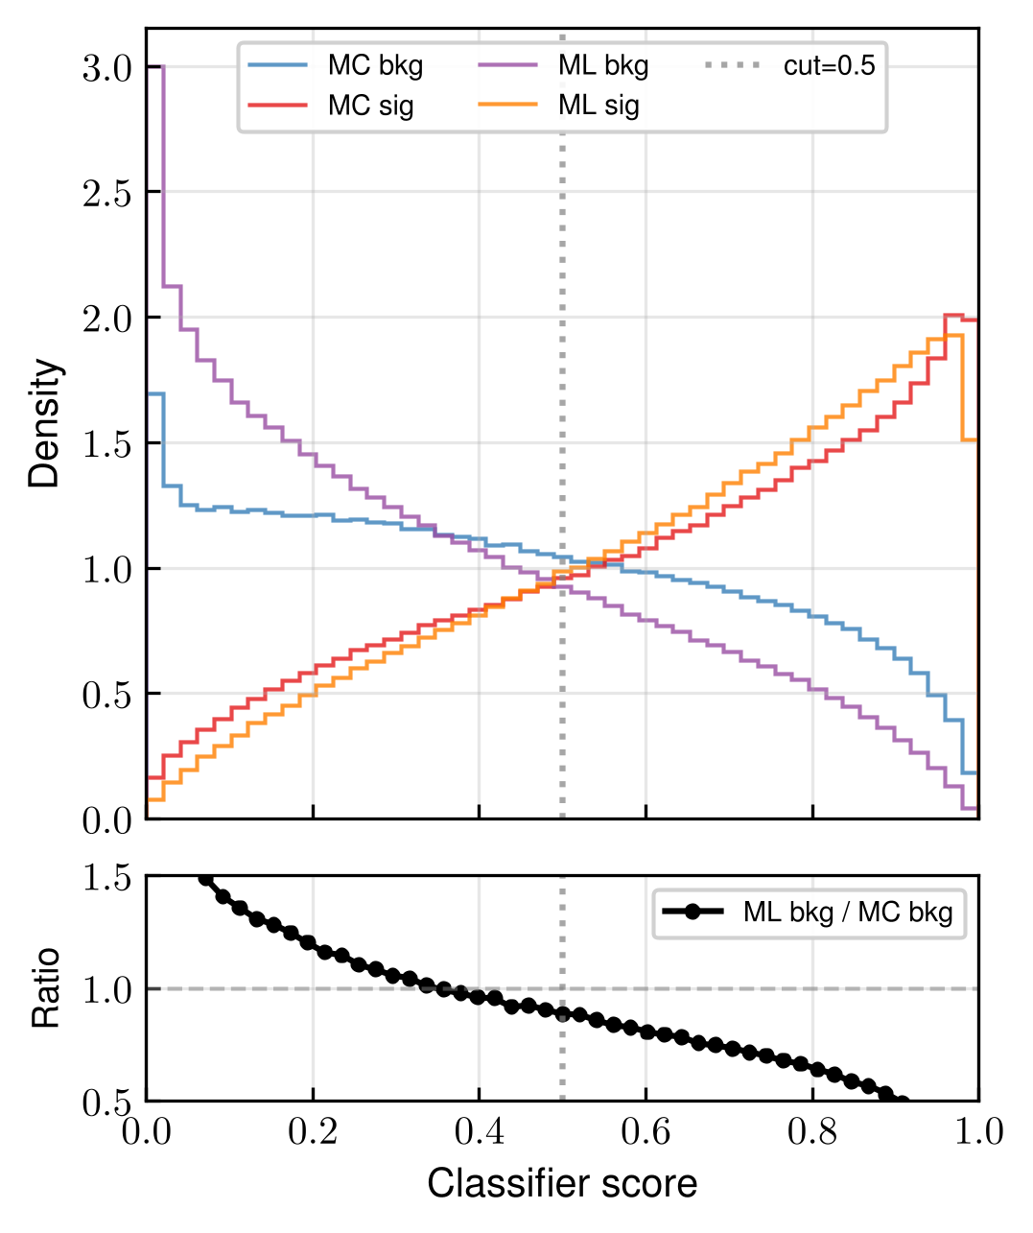
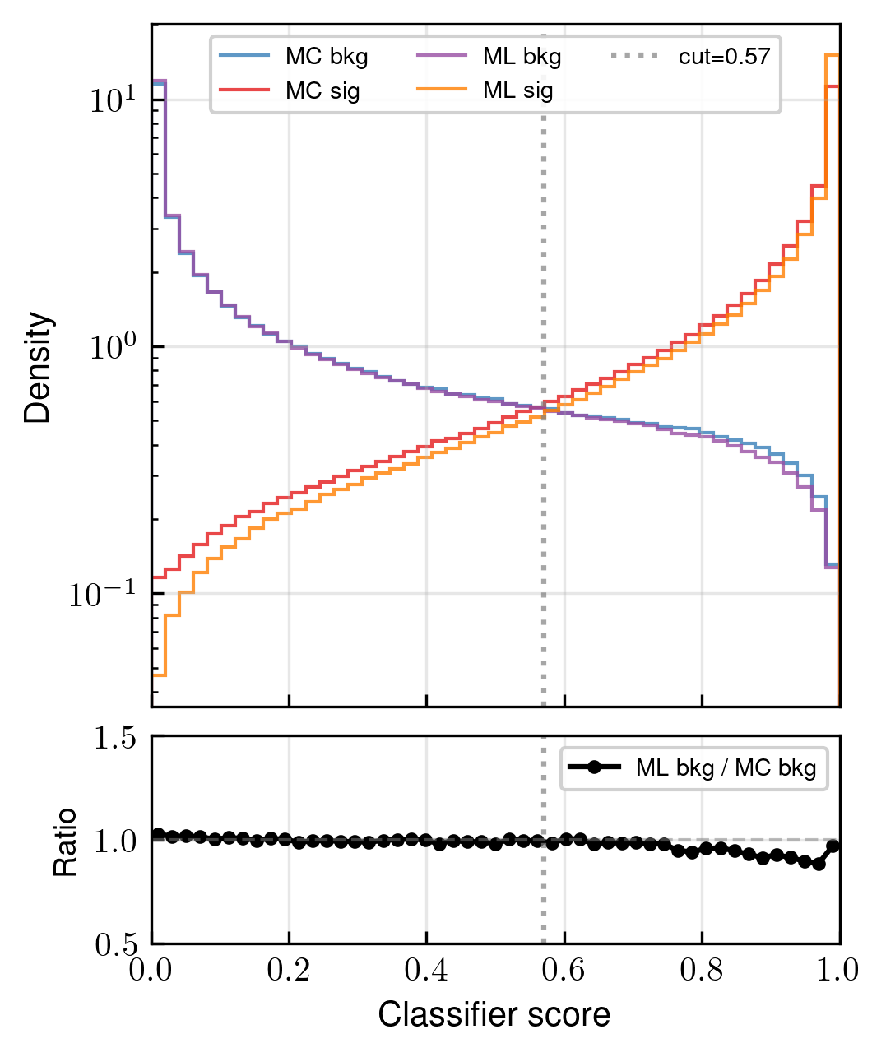
Sig.-Bkg. Ratios
Fully generated background events vs full MC background classifier (2.6-ish mil. samples)
DDPM
EDM (xl model)

Slide 16
Todo list
Improve the EDM framework – reweighing data, better networks?
New architectures -> small data dim. = problems with conv. networks
Consistency models for fast sampling
Training parameter and sampling ODE solver parameter optimization
Power function EMA parameter optimization/quality quantification
Autoguidance?
DDPM – better preconditioning?

Slide 17

Supplementary info
Before training the data is transformed using the Rank -> Gaussian scaler
Rank transform ~ ECDF/data sort and scale from -1 to 1
Apply invErf(scaled data) to get a normal distribution (see next few generated samples during training)
Slight numerical problems with boundary data close to $±$1

Slide 18
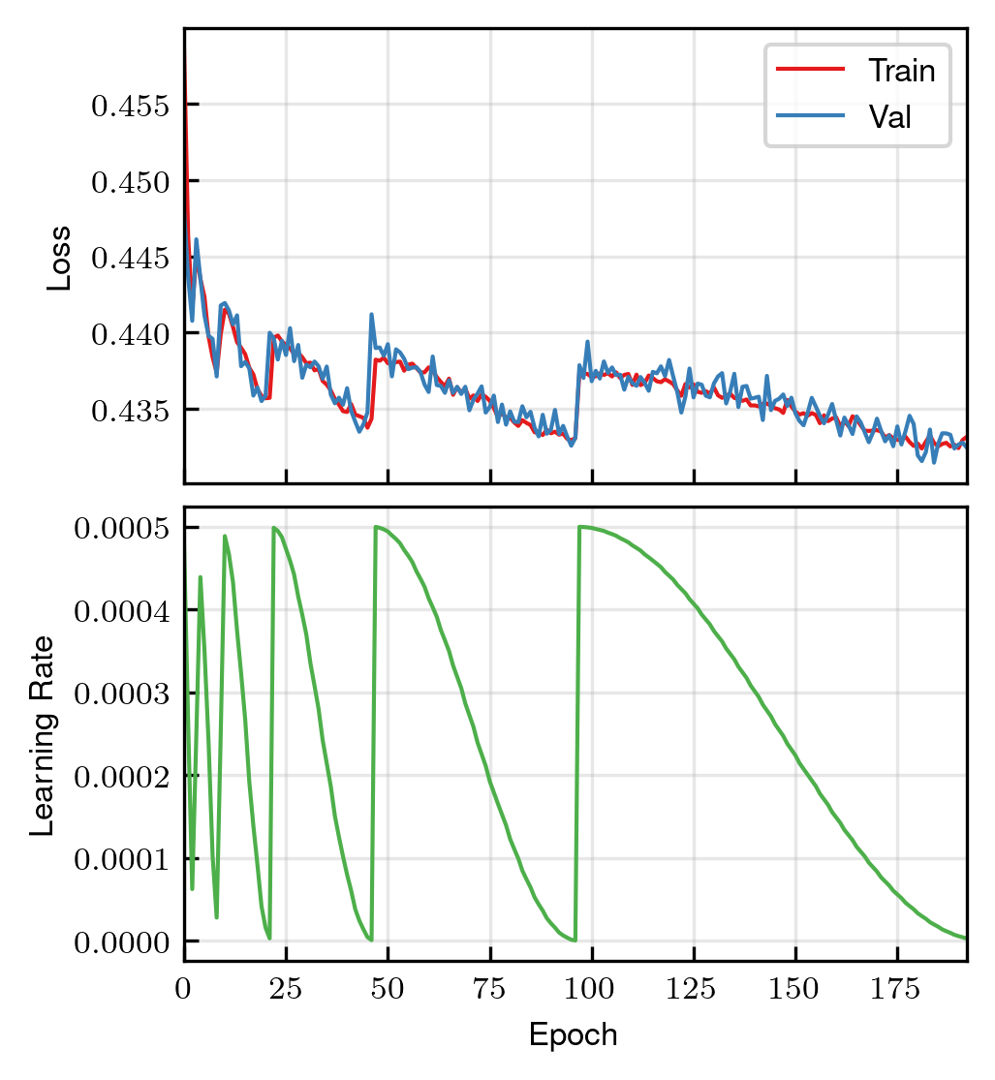
DDPM training

Slide 19
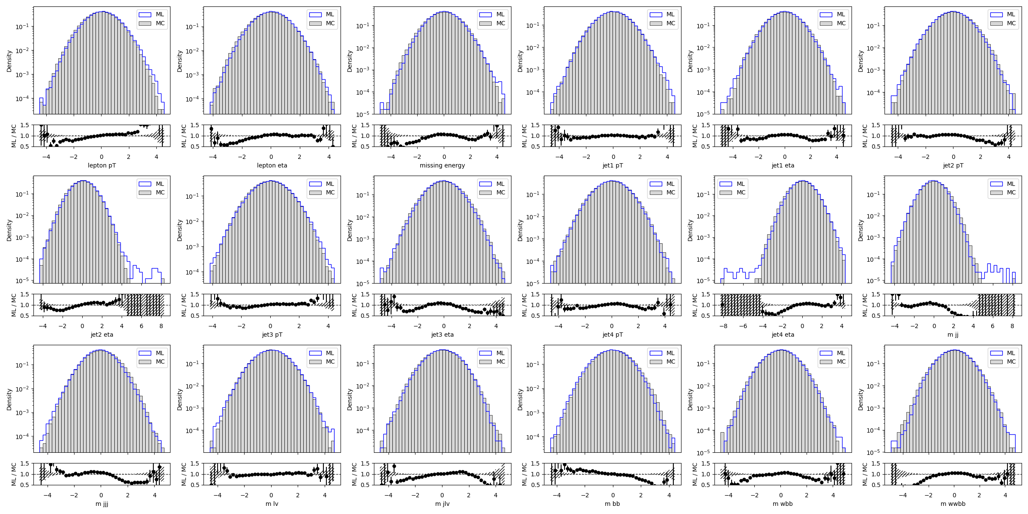
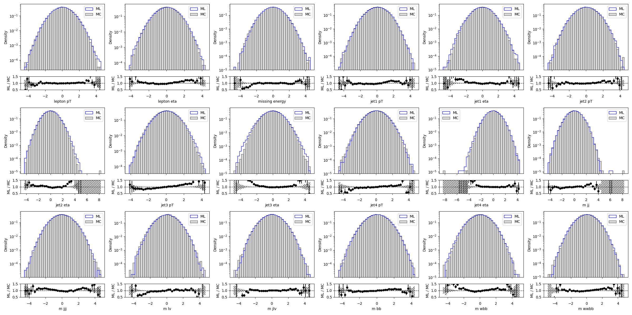
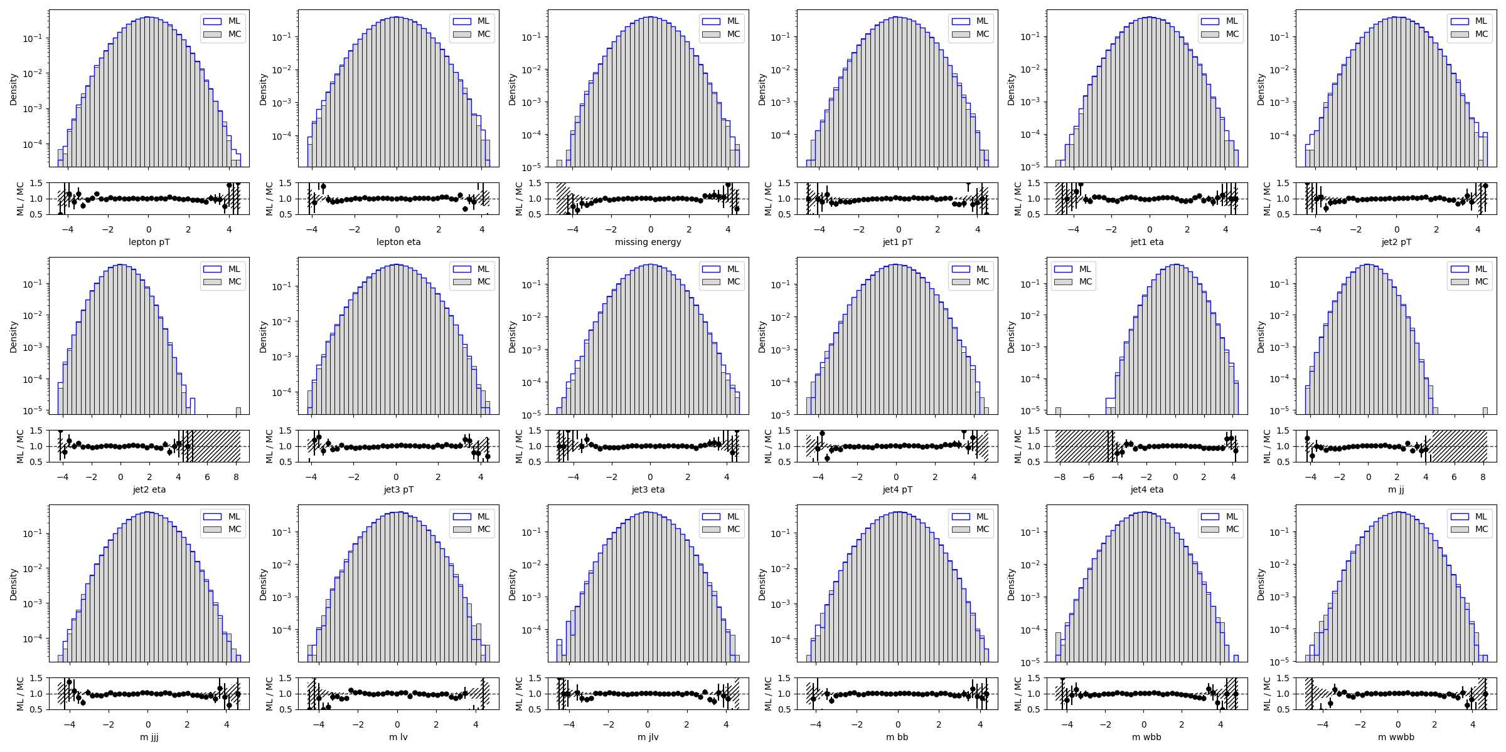
Training sampled snapshots for DDPM
Epoch 190/196
Epoch 114/190
Epoch 0/190

Slide 20
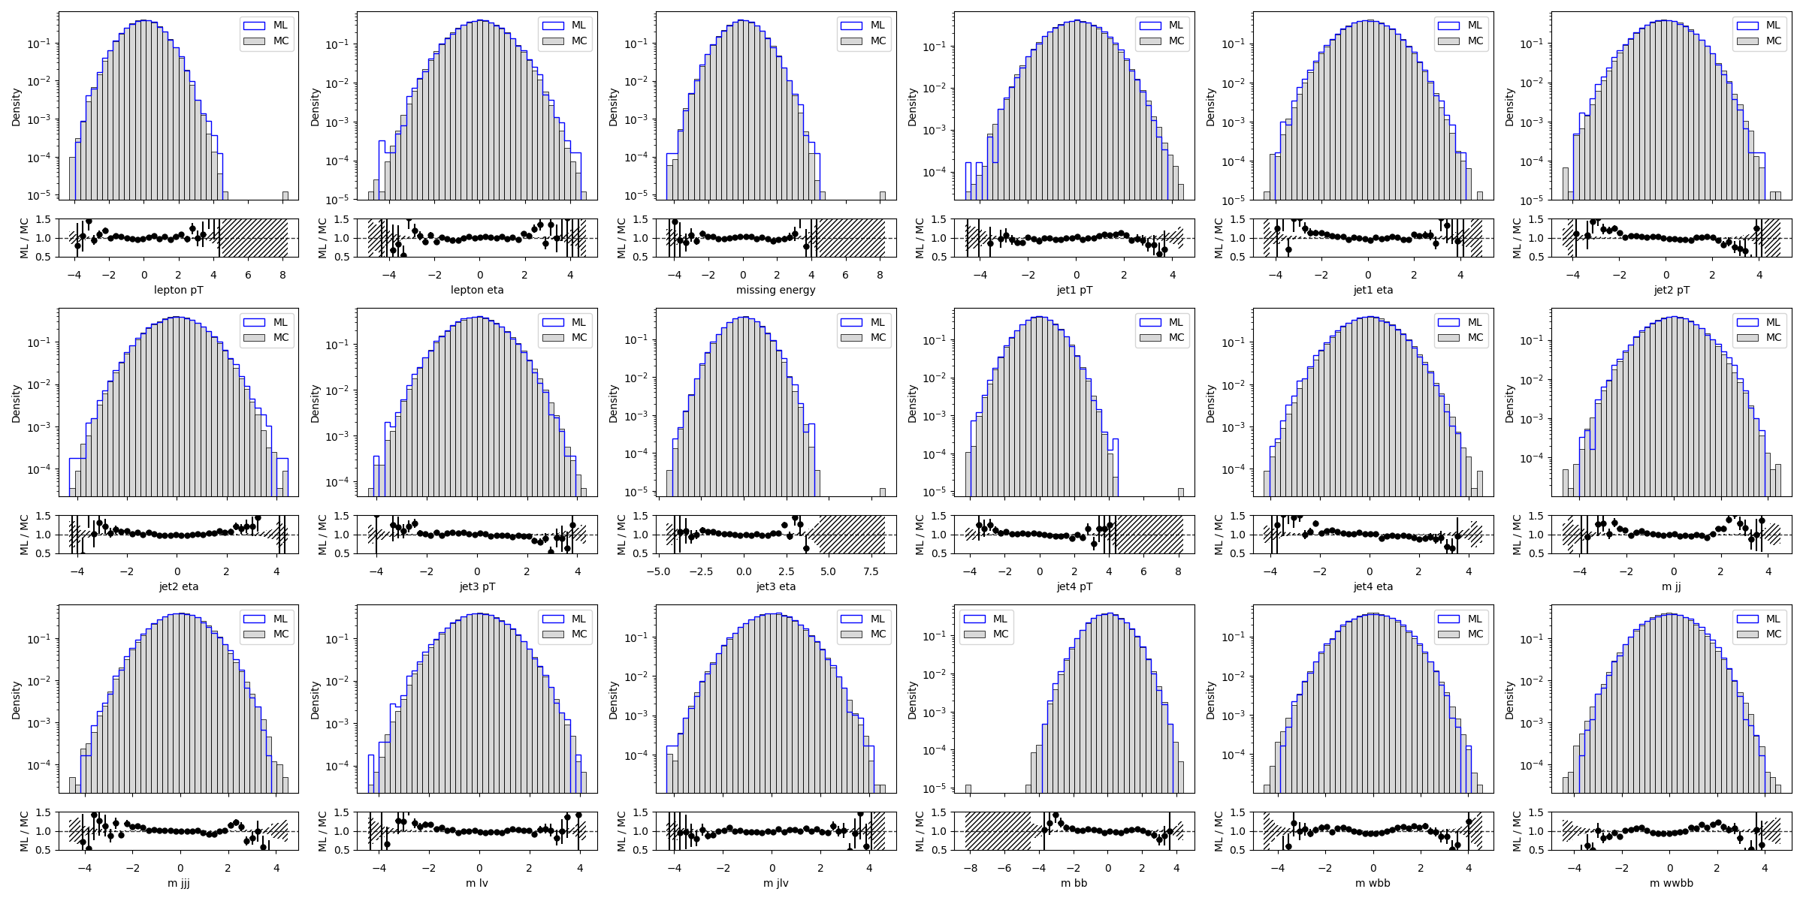
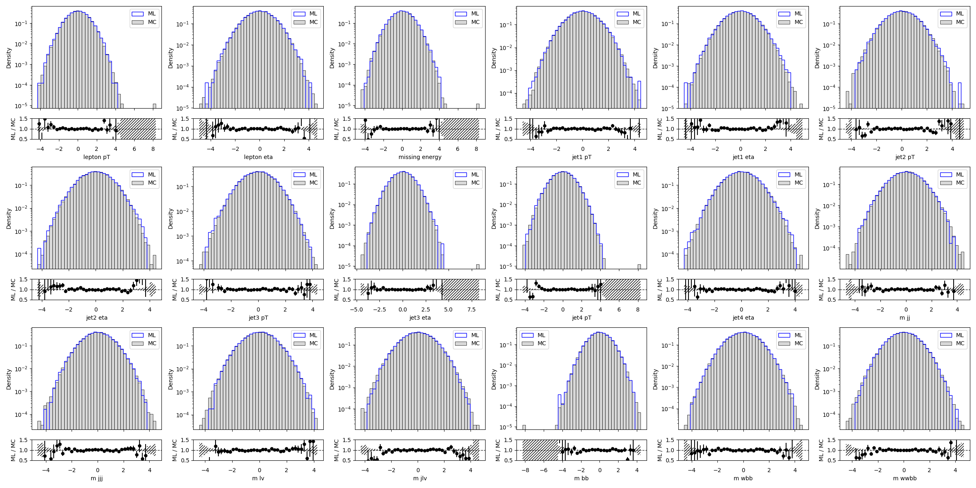
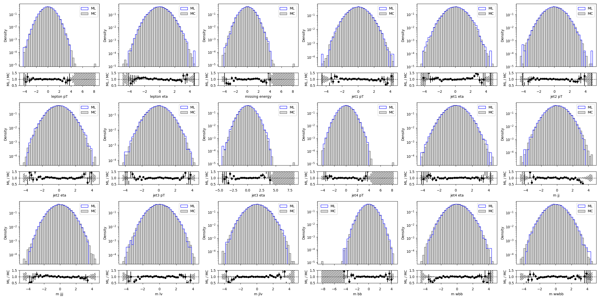
Training sampled snapshots for EDM xl
Epoch 96/190
Epoch 192/196
Epoch 0/190

Slide 21
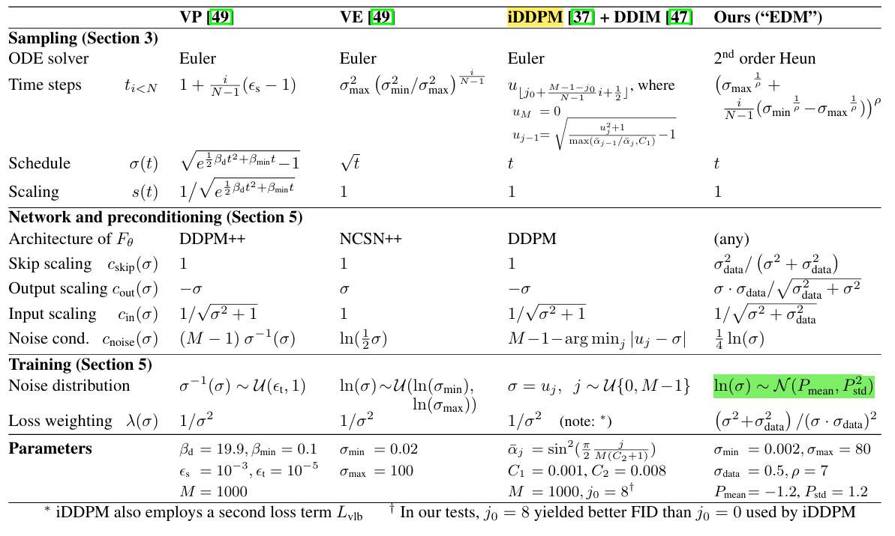
Parameters/SDE models overview

Slide 22
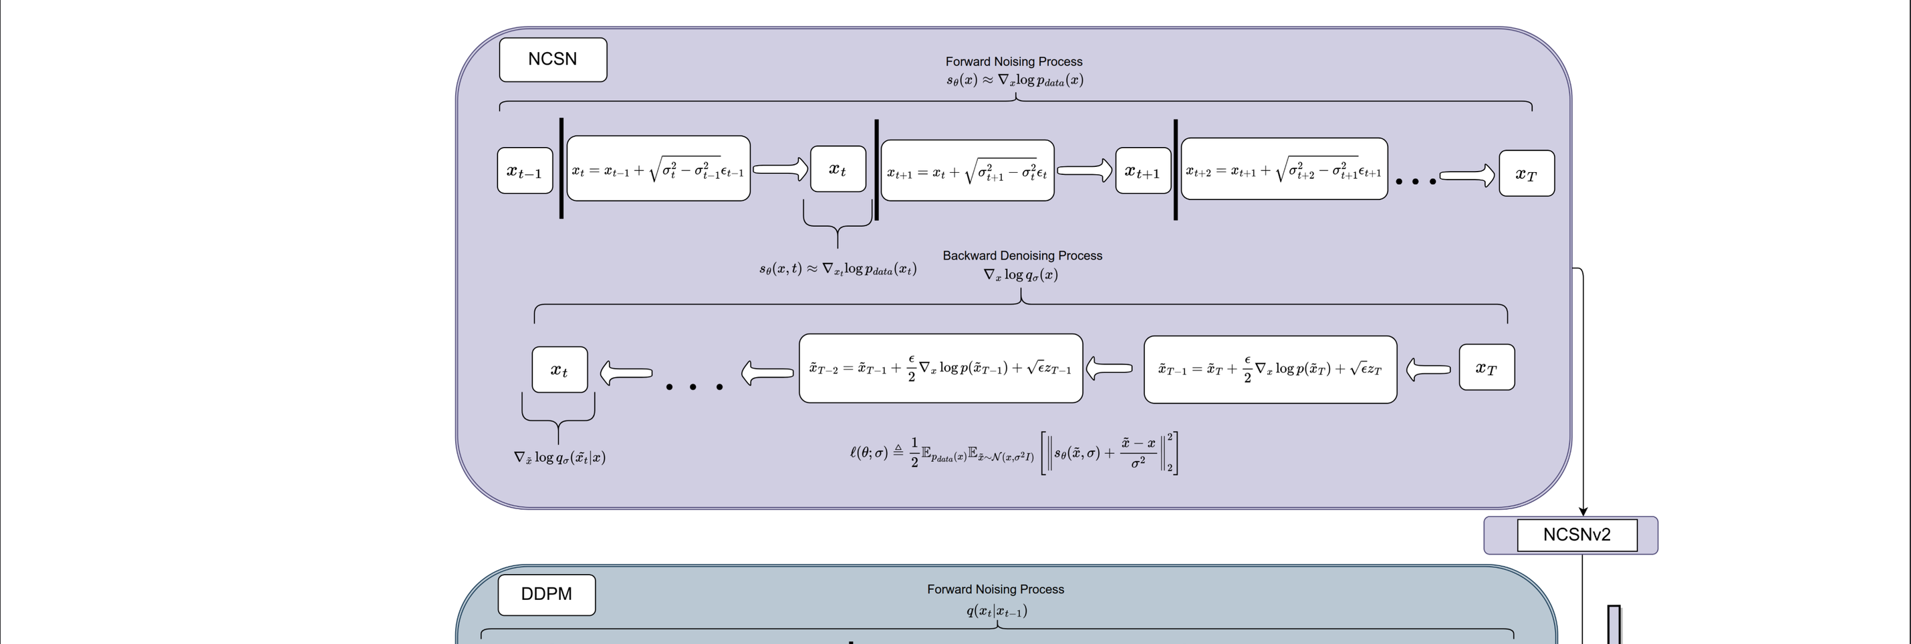
Diffusion models general overview

Slide 23
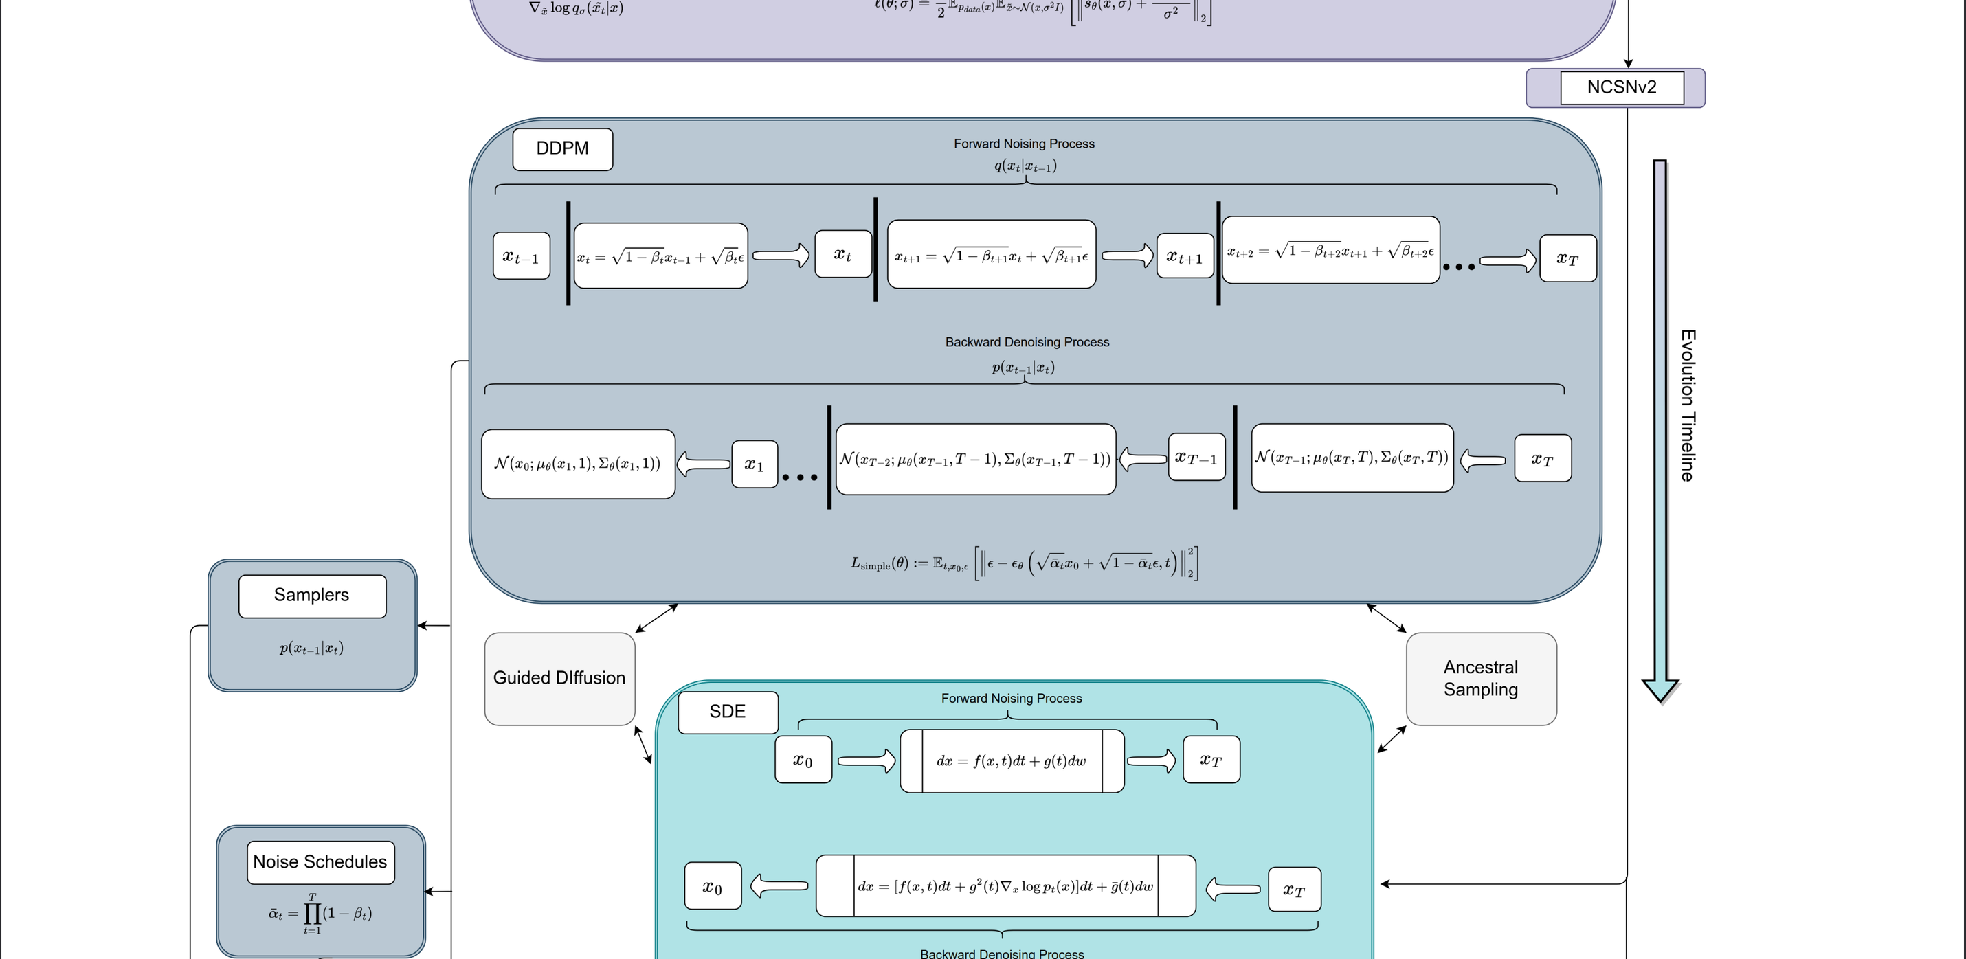

Slide 24
